Slide 1
Stephen Brannan
EXENATIDE Phase 3 Clinical trial
Lived experience

Slide 2
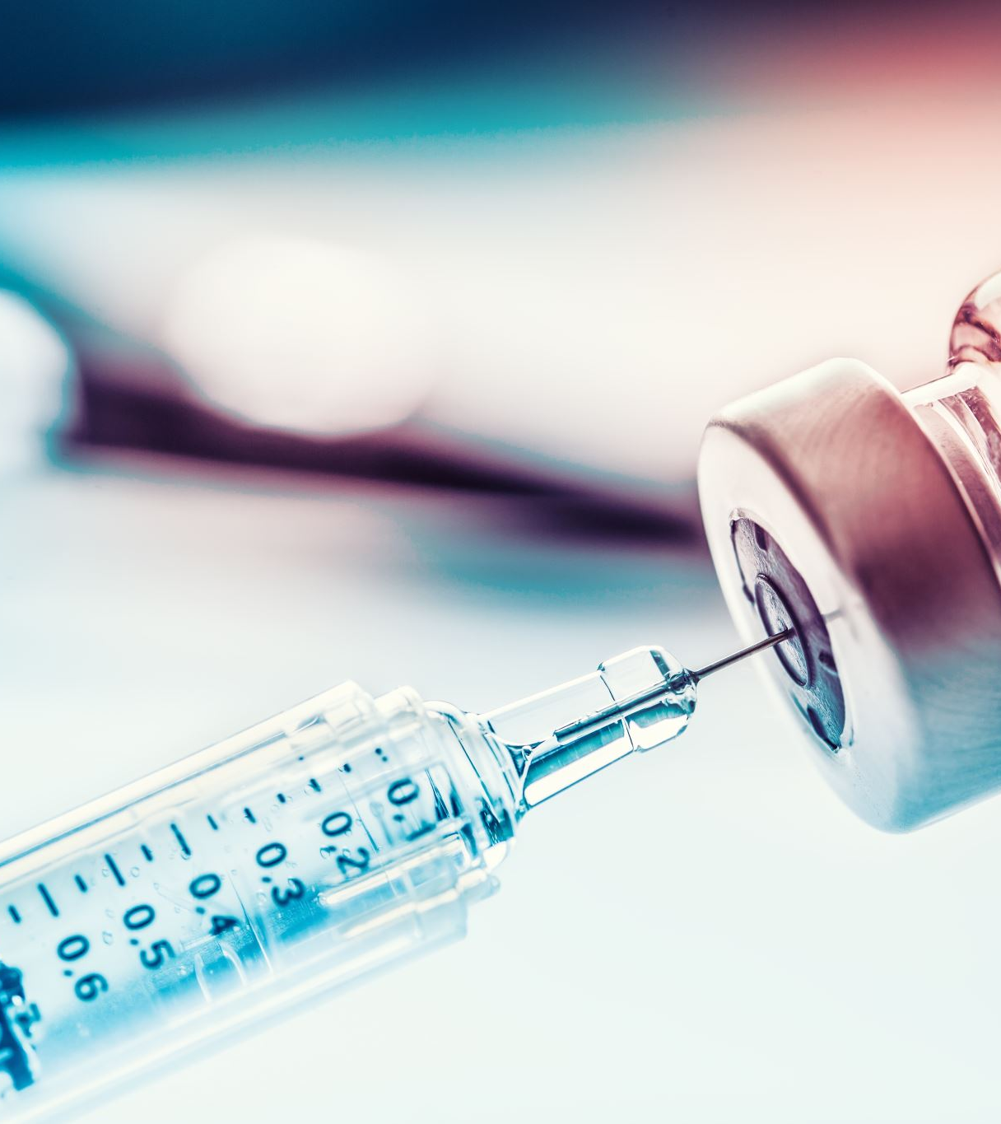
Exenatide
Already approved and used to treat type 2 diabetes
Injected subcutaneously
1 injection / week
Double blind trial
Placebo or drug – nobody knew

Slide 3
WHY
Regular assessment to monitor condition
To find a cure
To find something to treat symptoms
To find something to slow down progression
HOPE!

Slide 4
The pre-loaded syringe was huge! Interesting going on holiday

Slide 5
COMMENTS
Easy to participate
Looked after by research staff
It worked for me – my symptoms improved!
BUT
Frustration at the end

Slide 6
I want it back!

